Slide 1
Cells of the Immune System
Stem cells
Lymphoid Stem cells
Myeloid Stem cells
Neutrophils
..
…
..
Eosinophils
B cells
T cells
NK cells
Y
…
..
Basophils
Plasma
cells
Y
Y
Y
Macrophages
Y
Y
Mast cells
Y
Y
Th cells
Tc cells
Y
Effector T cells
Monocytes
Memory B cells
Memory T cells
Dendritic cells

Slide 2
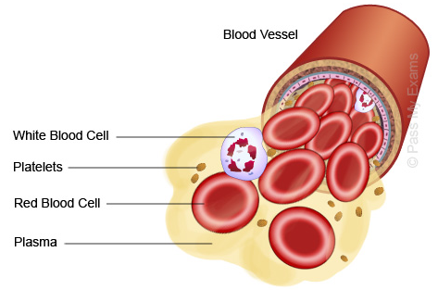
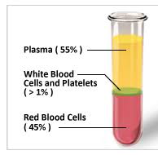

Slide 3
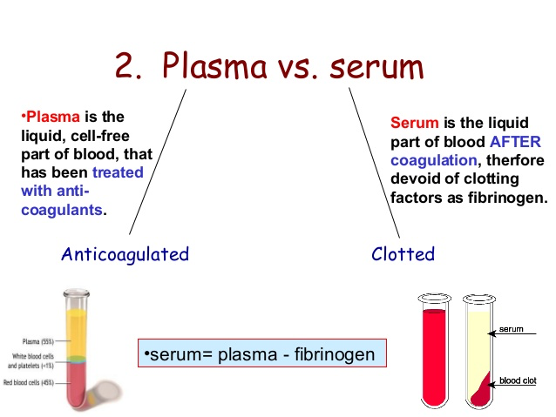

Slide 4
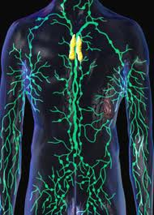
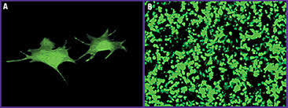
How the presence of pathogens is sensed ?
Lymphatic system
Dendritic cells (anti-CD11c)

Slide 5
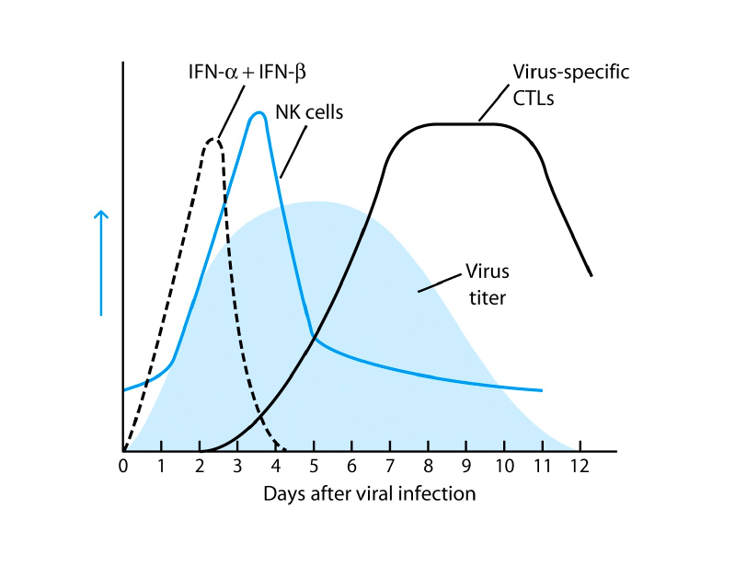
What happens in your body once a viral infection sets in

Slide 6
Types of Immune defenses
Humoral
-Anti Microbial Peptides,
-Complement
Cellular
Neutrophils
Macrophages
Dendritic cells
NK cells
Humoral
(Antibodies)
Cellular
T cells
(αβ and γδ)
NK T cells
Altered self
Line of defense
1
2
3
Adaptive
Mechanical and chemical
Anatomical and Physiological Barriers
(Intact skin, Mucous membrane,
Temperature, pH)
Innate
Phagocytic Barriers
Inflammatory Barriers and fever
Protein factors such as Interferons

Slide 7
Types of immune defenses against microbes:
Three types of defense mechanisms provide antimicrobial immunity. The first line of defense comprise of mechanical and chemical barriers that are intact skin, mucosal surfaces laden with mucocilliary expulsion system and anti-microbials. Second line of defense includes innate immune responses that comprise of both humoral and cellular components. The humoral components are complement proteins, defensins, lysozymes in various secretions and cellular components consist of innate immune cells such as neutrophils, basophils, eosinophils, macrophages, dendritic cells, NK cells etc. The third line of defense also includes both humoral (antibodies) and cellular components (T cells and B cells). NK cells, NKT cells and γδ T cells may be categorized to be working at the interface of innate and adaptive immune responses. There is cross regulation of innate and adaptive immune mechanisms as is shown by forward and reverse arrows. There is a sequential deployment of each of the defense mechanism to fend off any pathogenic insults.

Slide 8
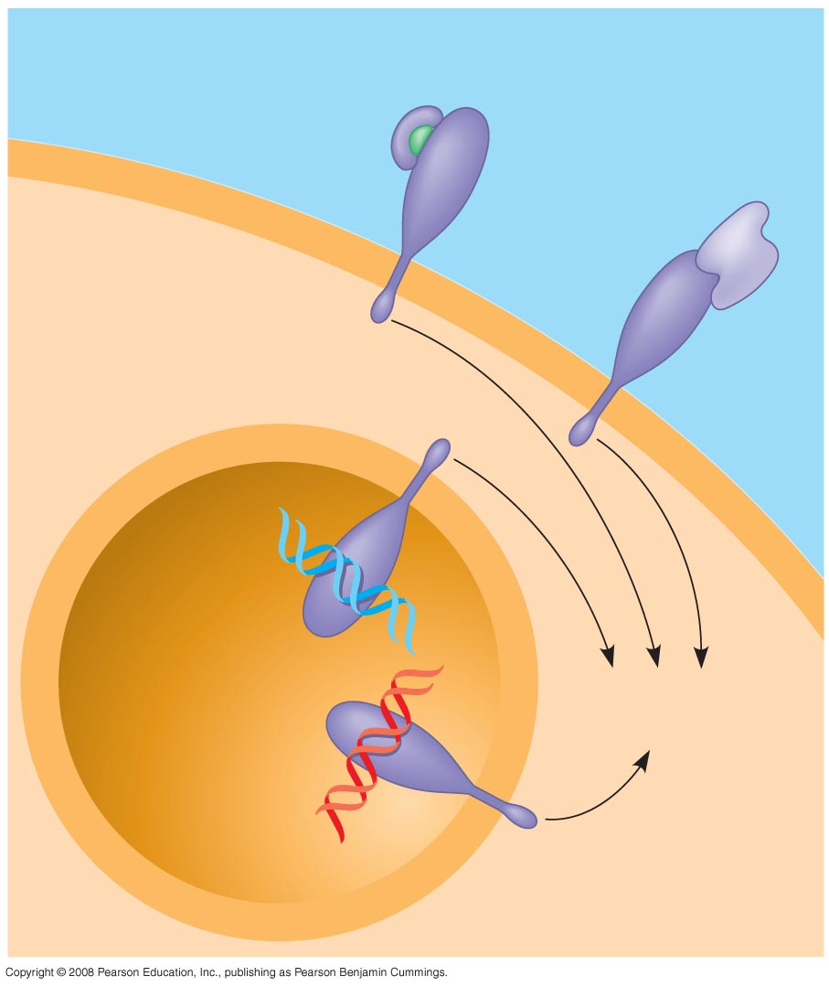
INNATE
TLR signaling
EXTRACELLULAR
FLUID
Lipopolysaccharide
Helper
protein
Flagellin
TLR4
WHITE
BLOOD
CELL
TLR5
VESICLE
TLR9
CpG DNA
TLR3
Inflammatory
responses
ds RNA

Slide 9
A white blood cell engulfs a microbe, then fuses with a lysosome to destroy the microbe.
There are different types of phagocytic cells:
Neutrophils engulf and destroy microbes.
Macrophages are part of the lymphatic system and are found throughout the body.
Eosinophils discharge destructive enzymes.
Dendritic cells stimulate development of acquired immunity.

Slide 10
Antimicrobial Peptides and Proteins
Peptides and proteins function in innate defense by attacking microbes directly or impeding their reproduction. Eg., Defensins
Interferon proteins provide innate defense against viruses and help activate macrophages.
About 30 proteins make up the complement system, which causes lysis of invading cells and helps trigger inflammation.

Slide 11
Inflammatory Responses
Cardinal Signs: Rubor (red), Calor (Heat), dolor (pain), Tumor (swelling), Functiolasia (loss of function)
Following an injury, mast cells release histamine, which promotes changes in blood vessels; this is part of the inflammatory response.
These changes increase local blood supply and allow more phagocytes and antimicrobial proteins to enter tissues.
Pus = a fluid rich in white blood cells, dead microbes, and cell debris, accumulates at the site of inflammation.

Slide 12
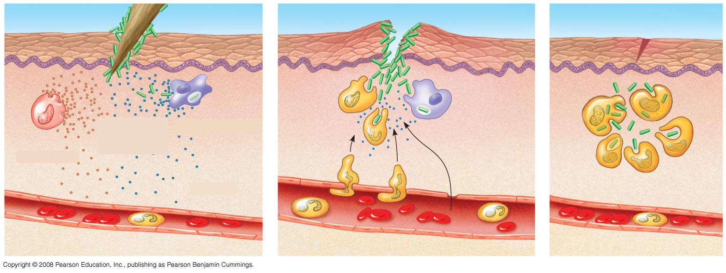
Major events in a local Inflammatory Response
1.
2.
3.
Pathogen
Splinter
Chemical
signals
Macrophage
Mast cell
Fluid
Capillary
Phagocytosis
Red blood cells
Phagocytic cell
Notes:
Figure 43.8 Major events in a local inflammatory response
For the Cell Biology Video Chemotaxis of a Neutrophil, go to Animation and Video Files.

Slide 13
Inflammation can be either local or systemic (throughout the body).
Fever is a systemic inflammatory response triggered by pyrogens released by macrophages, and toxins from pathogens.
Septic shock is a life-threatening condition caused by an overwhelming inflammatory response.

Slide 14
Natural Killer Cells
All body cells (except red blood cells) have a class I MHC protein on their surface.
MHC = Major Histocompatibility Complex , part of the extracellular matrix.
Class II MHC protein molecules are found on specialized cells(macrophage, Dendritic cells, B cells)
Cancerous or infected cells no longer express this MHC protein; natural killer (NK) cells attack these damaged cells.

Slide 15
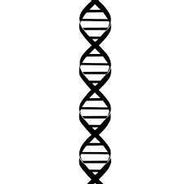
Cell Signaling: Type I IFN as an example
Type I IFN
Receptor subunit
Receptor subunit
Receptor subunit
Ligand binding
Receptor subunit
Receptor subunit
Receptor subunit
Receptor subunit
STAT binding
Receptor subunit
Phosphorylation
K
K
Phosphorylation
K
K
S
S
STAT Dimer formation
Anti-viral state
Translocation to Nucleus
Viral replication blocked
Nucleus
Degradation of mRNA
Inhibition of protein synthesis
Transcription
Oligoadenylate synthetase
Ribonuclease L
~~~~~~~
~~~~~~
~~~~
RNA transcripts
Translation
G protein-coupled receptors, Receptor tyrosine kinases, Ion channel receptors

Slide 16
Activation of JAK/STAT pathways by interferon signaling in target cells to confer anti-viral immunity.
The binding of type I IFN to receptors induces dimerization of the receptor. This leads to the activation of already bound Janus kinase (JAK). Kinases (K) autophosphorylate and phosphorylates the receptor and create docking sites for Signal Transducer and Activator of Transcription (STAT) protein (S) binding. Upon binding to the receptor STAT molecules are tyrosine-phosphorylated by the activity of JAKs, the STATs form active dimers that translocate into the nucleus to regulate transcription and translation of many genes including those required for the degradation of mRNA and inhibition of protein translation to create an anti-viral state in the cell.

Slide 17
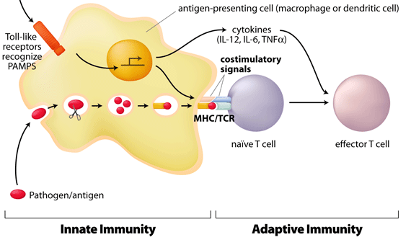
Induction of T cells response upon infection
Signal 1,2,3 : set the lymphocytes free

Slide 18
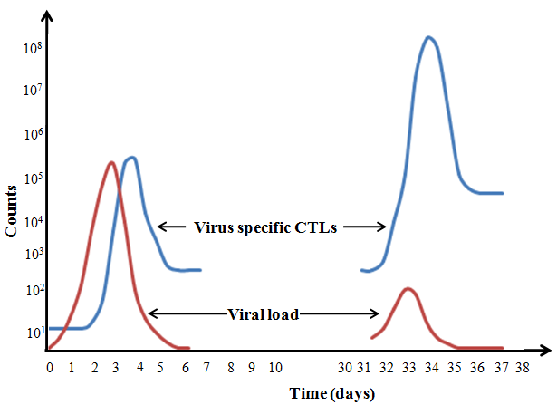
Halmarks of Adaptive Immunity
Recognition
Reaction
Remember

Slide 19
In Acquired Immunity, lymphocyte receptors provide pathogen-specific recognition
White blood cells called lymphocytes recognize and respond to antigens, foreign molecules.
Lymphocytes that mature in the thymus above the heart are called T cells, and those that mature in bone marrow are called B cells.
Lymphocytes contribute to immunological memory, an enhanced response to a foreign molecule encountered previously.
Cytokines are secreted by macrophages and dendritic cells to recruit and activate lymphocytes.

Slide 20
Acquired Immunity = Active Immunity: Specific
B cells and T cells have receptor proteins that can bind to foreign molecules.
Each individual lymphocyte is specialized to recognize a specific type of molecule.
An antigen is any foreign molecule to which a lymphocyte responds.
A single B cell or T cell has about 100,000 identical antigen receptors.

Slide 21
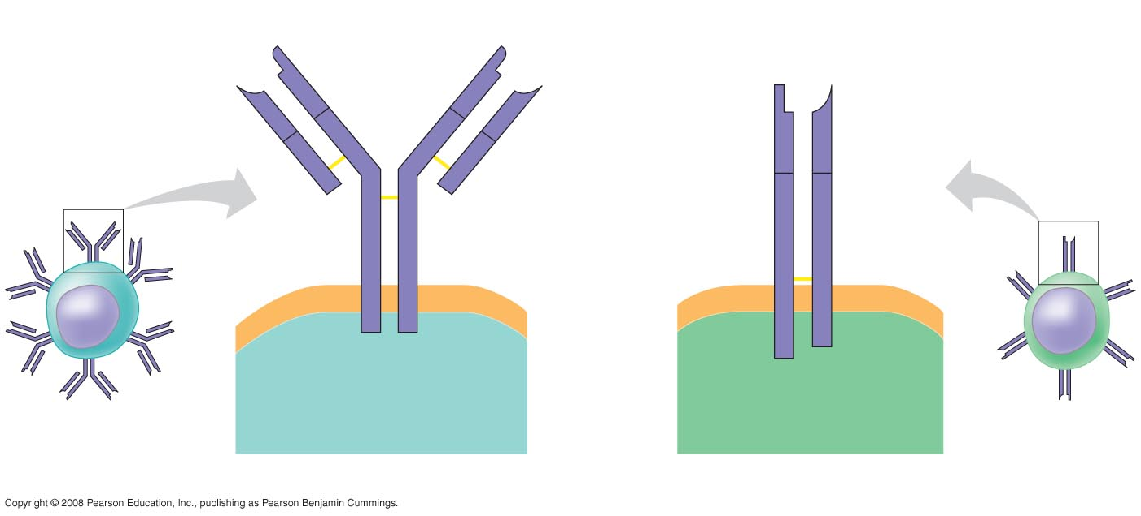
Antigen receptors on lymphocytes
Antigen-
binding
site
Antigen-
binding site
Antigen-
binding
site
V
Disulfide
bridge
V
V
V
Variable
regions
V
V
C
C
C
C
Constant
regions
C
C
Light
chain
Transmembrane
region
Plasma
membrane
Heavy chains
 chain
 chain
Disulfide bridge
B cell
Cytoplasm of B cell
Cytoplasm of T cell
T cell
B cell receptor
T cell receptor
Notes:
Figure 43.9 Antigen receptors on lymphocytes

Slide 22
All antigen receptors on a single lymphocyte recognize the same epitope, or antigenic determinant, on an antigen.
B cells give rise to plasma cells, which secrete proteins called antibodies or immunoglobulins.

Slide 23
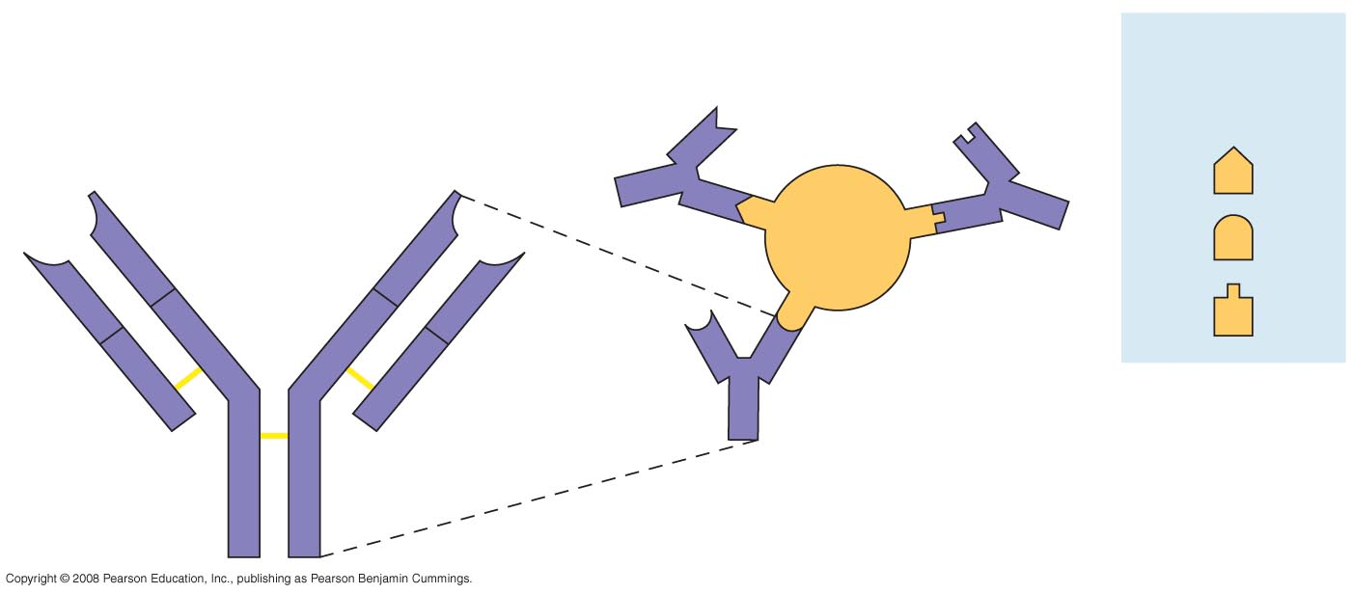
Epitopes = antigen determinants
Antigen-
binding
sites
Epitopes
(antigenic
determinants)
Antigen-binding sites
Antibody A
Antigen
Antibody C
V
V
V
V
C
C
C
C
Antibody B
Notes:
Figure 43.10 Epitopes (antigenic determinants)

Slide 24
The Antigen Receptors of B Cells and T Cells
B cell receptors bind to specific, intact antigens.
The B cell receptor consists of two identical heavy chains and two identical light chains.
The tips of the chains form a constant (C) region, and each chain contains a variable (V) region, so named because its amino acid sequence varies extensively from one B cell to another.
Secreted antibodies, or immunoglobulins, are structurally similar to B cell receptors but lack transmembrane regions that anchor receptors in the plasma membrane.

Slide 25
Each T cell receptor consists of two different polypeptide chains. The tips of the chain form a variable (V) region; the rest is a constant (C) region.
T cells can bind to an antigen that is free or on the surface of a pathogen.
T cells bind to antigen fragments presented on a host cell. These antigen fragments are bound to cell-surface proteins called MHC molecules.
MHC molecules are so named because they are encoded by a family of genes (many unique / specific) called the Major Histocompatibility Complex.

Slide 26
The Role of the MHC
In infected cells, MHC molecules bind and transport antigen fragments to the cell surface, a process called antigen presentation.
A nearby T cell can then detect the antigen fragment displayed on the cell’s surface.
Depending on their source, peptide antigens are handled by different classes of MHC molecules.

